Slide 1








IEEE AP-S/URSI 2017 - July 9-14 Companion Program Overview
This PowerPoint presentation gives information for companions and registered attendees about activities around San Diego.
To navigate this slide show, click on blue arrows or click enter.
Slides 1 – 4: Introductory Information
Slides 5 – 13: Tours
Slides 14 – 25: Activities on The Embarcadero
Slides 26 – 36: On Your Own Activities
Slide 37: Adventurous Activities
Slides 38 – 40: Useful URL links, apps, & maps!
  Check for updated information.
  This site is for general information only.
  We cannot guarantee its accuracy.
  If you find any inaccuracies or would like additional information, please contact:
    rockway4@gmail.com
    suelstone@hotmail.com

Slide 2






Tours: | Conference Tours’ Overview: | Details:
Sunday, July 9 Meet in Main Lobby by Concierge Desk @ 5:00pm | Guided orientation tour of sites around the Manchester Grand Hyatt San Diego | Tour 5:00 pm – 7:00 pm Cost: Complimentary
Monday, July 10 Meet in main lobby by Concierge Desk @ 8:15 am | Visit the San Diego Zoo and Balboa Park Register for this Tour on Conference Registration | Bus leaves at 8:30 am to 3:30pm Cost: Balboa Park ~20.00 San Diego Zoo & Balboa Park $70.00
Monday, July 10 Meet in main lobby by concierge @ 8:00am | Viejas Outlet Mall & Casino Excursion No preregistration necessary Must join V-Club for return trip | Must be over 18 years old, with picture ID Cost: Complimentary transportation Group will walk to 4th & Market for bus
Tuesday, July 11 Meet in main lobby by concierge @ 11:30 am | Coastal Winery Tour Sign up directly with Coastal Wine Tour for July 11th -12:15 tour. Email address: tasty@sdbeerwinespirits.com (858)-551-5115 | A member of the Companion Committee will escort you to Old Town Trolley Station to meet your guide Tour ends at Old Town Station at 7:30 pm Cost: $150.00
Tuesday, July 11 Meet in main lobby by concierge @ 8:00 am | Visit UCSD and SDSU Register for this tour on the Conference Registration site. | Cost: $15.00 Information also provided for PLNU (Point Loma Navarene University) and USD (University of San Diego).
Wednesday, July 12 Meet in main lobby by concierge @ 9:45 | Surfing lessons with San Diego Surf School Sign Up directly with Surf School – for 7/12 10:30 lesson sandiegosurfschool@gmail.com (858)-205-7683 | 90 minute lesson starting at 10:30 Cost: $60.00
Thursday, July 13 Meet in main lobby by Concierge Desk at 11:30 am | Gaslamp and Little Italy Food Tour Register this Tour on Conference Registration | Walk to 1st restaurant to meet guide for 12:00 to 4 tour Cost: $50.00
Friday, July 14 Meet in main lobby by concierge @ 10:00 am | Tea at Old Town’s Heritage Park Register this Tour on Conference Registration | Group will take trolley to Old Town and walk ½ mile to Coral Tree Tea House Cost: $40.00

Slide 3


Some Basic Information
(Nuts and Bolts)
1. Please visit the Companion Suite, the Manchester Grand Hyatt Marine Room. (Located adjacent to Sally's Restaurant, and by Seaport Village overlooking the bay.) Networking opportunities Light breakfast available for Registered Companions, information on activities and fellowship. Open 7:00 am to 4:00 pm
2. Mass Transportation in San Diego: Metropolitan Transit System (MTS)
MTS General Information: URL:https://www.virtualtourist.com/travel/North_America/UnitedStates_of_America/California/San_Diego755464/Transportation-San_Diego-TG-C-1.html | A Compass Card is useful to ride the bus, trolley and coaster. Can be filled online or url below URL:http://511sd.com/compass/compass | Need Transportation Information? Please ask the Hyatt’s Concierge Staff URL:https://manchester.grand.hyatt.com/en/hotel/our-hotel/transportation.html
3. Downtown Visitor’s Center Address: 996 N Harbor Dr Phone: (619) 236-1242

Slide 4



Fun Under the Sun
San Diego
Helpful Sites
GeneraI links for things to do in San Diego: URL: https://www.sandiego.org/ URL: https://www.sandiego.org/explore/things-to-do.aspx URL: https://www.sandiego.org/articles/25-fun-free-things-to-do-in-san-diego.aspx Activities for kids: http://lajollamom.com/best-things-to-do-in-san-diego-with-kids/ https://www.sandiego.org/articles/family/attractions.aspx
Transportation access from the Manchester Granc Hyatt San Diego: Enjoy easy access to public transportation. Our concierge can assist with a taxi, rental car, train schedule or airport shuttle. The Hyatt is a stop on the Big Bay Shuttle and behind the ferry to Coronado Island. https://manchester.grand.hyatt.com/en/hotel/our-hotel/transportation.html

Slide 5






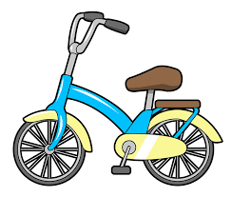

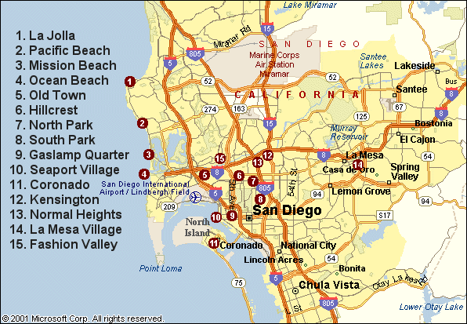
Places to Go & Useful Information
Conference
Tours
Tours
Stickers by Sandstone
Transportation
EARLY
SIGN UP
Click on blue
arrows to move between
PowerPoint slides
APPS/URL’s
For
San Diego
On Your
Own Around
San Diego
On your own
Maps
Notes:
For reproduction steps for this slide, refer to slide number 8 in this template.

Slide 6
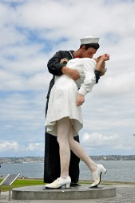
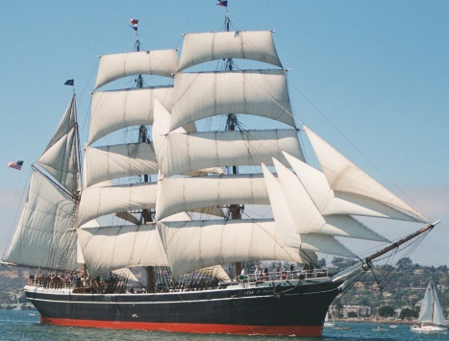
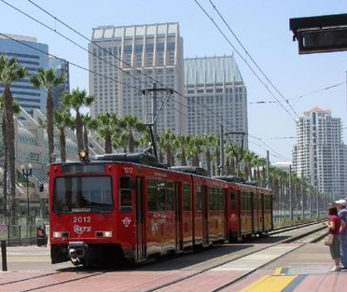
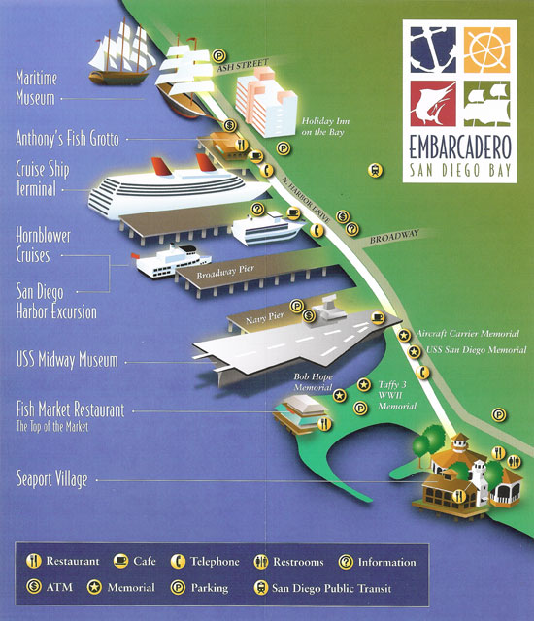


Sunday, July 9: Orientation Tour and Strolling the Embarcadero
https://www.sandiego.org/articles/downtown/the-embarcadero-in-san-diego-ca.aspx
Tours
EARLY
SIGN UP
Come join us to learn about the neighborhood surrounding the Manchester Grand Hyatt San Diego.
We will point out the Trolley Stop
Santa Fe Station (train)
Tour bus pick-up area
Casual and fine dining
Gaslamp
Little Italy
Seaport Village
And the many wonders on
The Embarcadero
Star of India
Trolley
Hyatt
Time: 5:00 – 7:00 pm Meet: At the Hotel’s Main Lobby by the Concierge Desk Cost: Complimentary

Slide 7
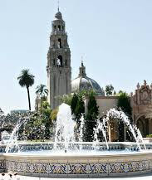

Tour on Monday, July 10:
San Diego’s Balboa Park has two sites:
San Diego Zoo
Balboa Park
Tours
Preregistration required Time: 8:30 am Meet: Manchester Grand Hyatt San Diego near Concierge Desk at 8:15 am Cost: Balboa Park, $20.00/person Cost: Balboa Park and Zoo, $72.00 adults;
San Diego Zoo
 | Balboa Park Museums, etc.
Zoo Apps: URL:https://play.google.com/store/apps/details?id=com.mobileroadie.app_1901&hl=en | Balboa Park Apps: URL:http://www. balboapark.org/mobileapps
URL:http://zoo.sandiegozoo.org/ | URL:http://www.balboapark.org/in-the-park/Museums

Slide 8
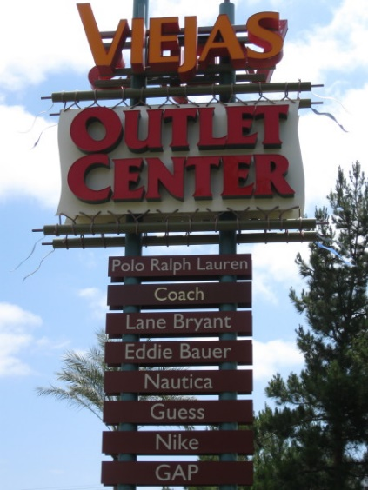
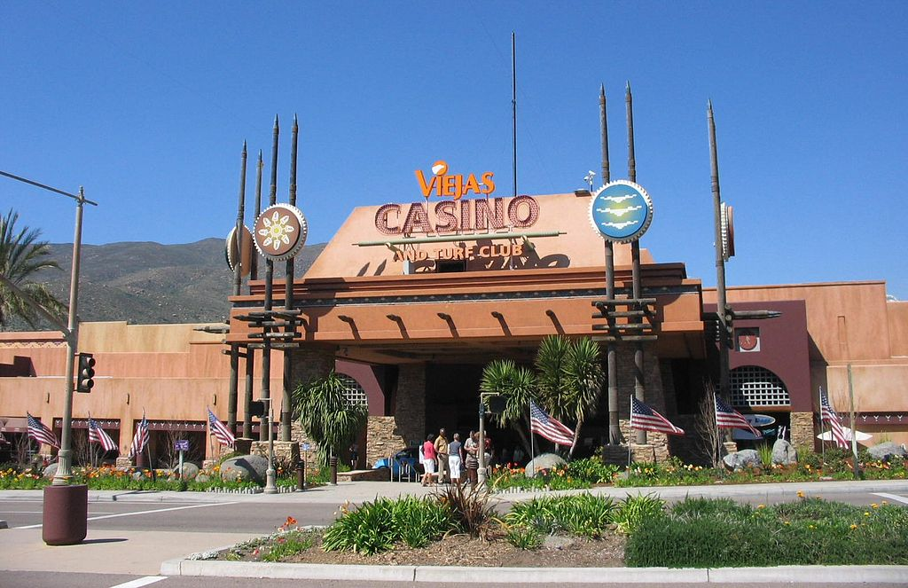
Tour on Monday, July 10:
Viejas Outlets and Casino
Tour
Time: 8:00 am Meet: Meet in Main Lobby at Manchester Grand Hyatt San Diego Cost: Complimentary, with photo ID – must be over 18 years old
Notes:
San Diego’s back country is desert and very different from the San Diego that most people know along the coast.
The Viejas Indian Reservation has a bus that picks up at 4th and Market Street, a few blocks from the hotel. It takes people to the Casino complex.
People riding the bus must sign up for the V Club to ride the bus back to San Diego. For this, you need to bring your photo ID and be 18 years or older.

Slide 9

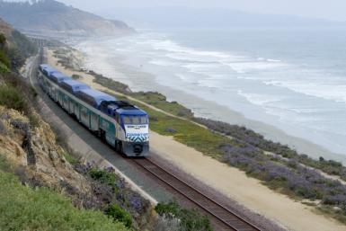
Tour on Tuesday, July11:
Coastal Wine Train Tour
Tours
EARLY
SIGN UP
Courtesy NCTD
Preregistration with tour company required Time: 12:15 – 7:30 Meet: In main lobby @ 11:30 Cost: ≈ $150.00
Notes:
After taking the Trolley to Old Town, participants will ride the train along the Pacific Ocean to a number of coastal villages and visit their urban wineries.
This tour includes up to 15 wine tastings, small appetizer portions of food, a light lunch and guided tours.
Coaster train travels up the coast from downtown San Diego. This is a five-hour tour.
Phone: (858) 551-5115
URL:https://sandiegobeerwinespiritstours.com/activities/winery-train-tour/

Slide 10




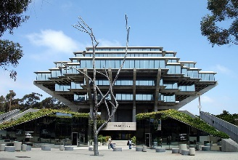
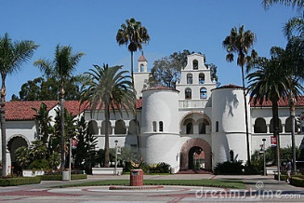
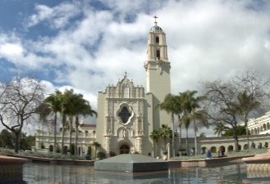
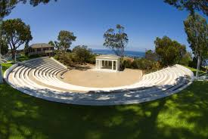
Tour on Tuesday, July 11:
Tour 2 San Diego Universities
EARLY
SIGN UP
Preregistration with conference required Time: 8:00 am Meet: In Main Lobby Cost: $15.00
University | URL Address | Location
University of California at San Diego (UCSD) (Tour will visit) | https://ucsd.edu/ | La Jolla
San Diego State University (SDSU) (Tour will visit) | https://www.sdsu.edu/ | Inland San Diego
University of San Diego (USD) (Information Only) | http://www.sandiego.edu/ | Overlooks Mission Bay
Point Loma Nazarene University (PLNU) (Information Only) | http://www.pointloma.edu/ | Point Loma

Slide 11

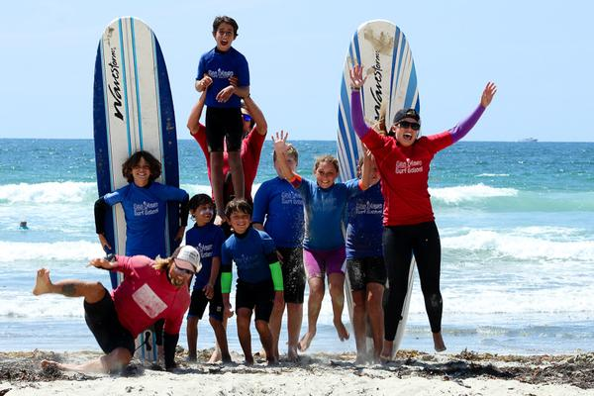
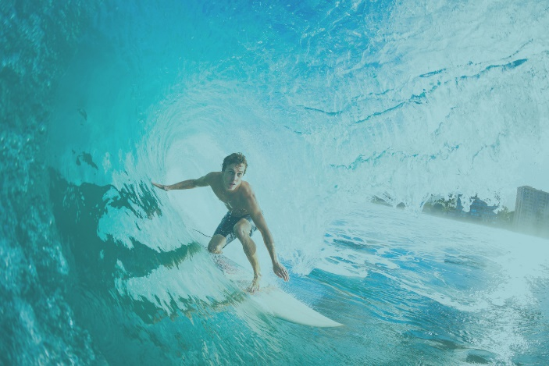
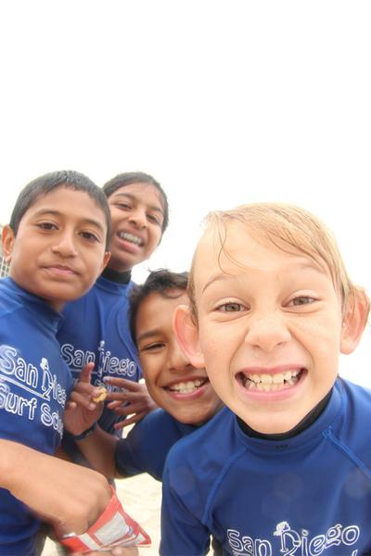
Tour on Wednesday, July12: Surfing Lessons at San Diego Surf School
Phone # (858)205-7683
URL: https://www.sandiegosurfingschool.com/
EARLY
SIGN UP
Tours
Preregistration with Surf School required Time: Meet in Lobby by concierge @ 9:45 am Lessons are from 10:30 am to 12:00 noon Group lessons are 4:1 ratio, surfers-to-instructor Sign-up directly with San Diego Surf School – 7/12 - 10:30am lesson Sizes for wet suit will be required at that time sandiegosurfschool@gmail.com (858)-205-7683 Cost: A group lesson is $55.00 per surfer, before tax & gratuity Includes 90 minutes with a board, wetsuit, and instructor

Slide 12
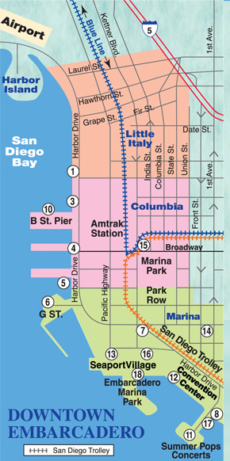
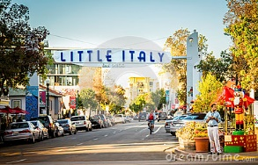
Tour on Thursday, July 13
Food Tour
Tours
EARLY
SIGN UP
Preregistration with conference required Time: 12:00 Meet: Main Lobby @ 11:30 to walk to restaurant Cost: ~ $50.00 Mention any special food needs at preregistration time URL: http://bitesandiego.com/portfolio/downtown-little_italy_walking_tour/
You are here

Slide 13

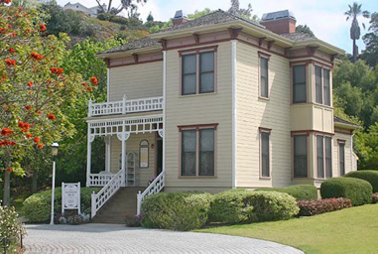

Tour on Friday, July 14:
Tea In Old Town
EARLY
SIGN UP
Preregistration with conference required Time: 11:00 am Meet: Main Lobby by the Hotel’s Concierge Desk at 10:00am Cost: $40.00 Visit The Coral Tree Tea House website for more information - http://www.coraltreeteahouse.com/CoralTreeTeaHouse/Welcome.html
Tours

Slide 14
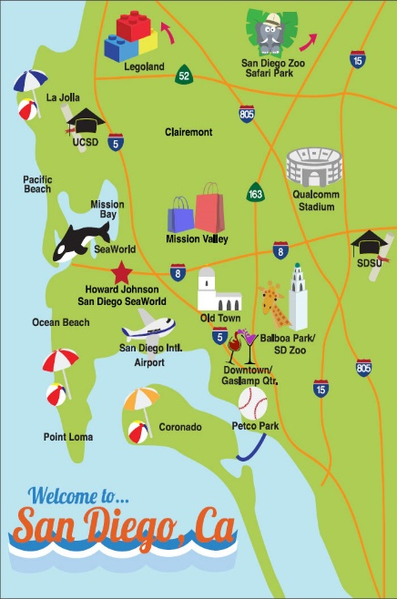
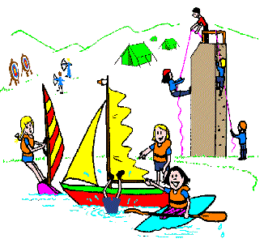
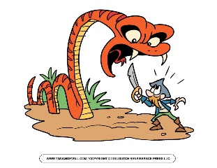
Enjoy doing things on your own?
Check out these sights!
On your own
Suggested Activities Around Embarcadero
Family Friendly Activities
Around San Diego
Awesome
Adventurous
Activities
Notes:
For reproduction steps for this slide, refer to slide number 8 in this template.

Slide 15
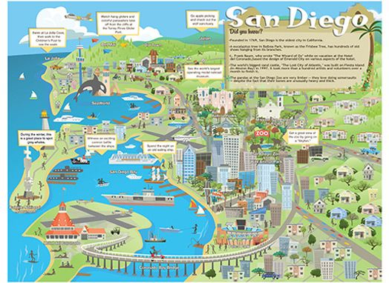



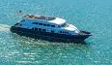


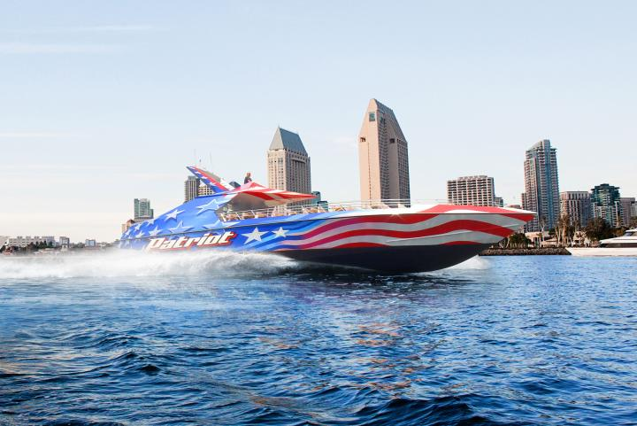



Activities Located on
San Diego’s Embarcadero
On your own
Casual Dining
on
Embarcadero
Gaslamp
Quarter
Harbor
Cruises
Hornblower’s
Whale Watching
Shopping
Hop on Hop Off Old Town Trolley Tours
San Diego and Coronado Tour
La Jolla and San Diego Beaches Tour
San Diego Seal Amphibious Boat Tour
Maritime Museum
on the Embarcadero
Patriot
Jet
Boat
Summer
Pops
San Diego Seal Tours

Slide 16
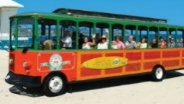
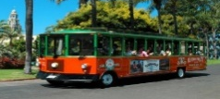

Sightseeing With Hop-on & Hop-off Buses
On your own
Information and Tickets for Old Town Trolley Tour Company URL: https://www.trolleytours.com/san-diego
Tour La Jolla (619) 500-9477 Board our colorful Beach Cruiser and be transported to the top of Mt. Soledad, 822 feet above sea level Descend into La Jolla, “The Jewel” of San Diego Drive past The Cove and the famous Children’s Pool | Tour Old Town & Downtown (619) 298-8687 Explore Old Town Tour the Midway Aircraft museum Check out the historic Gaslamp Quarter Take the trolley to Coronado Stroll through El Prado See the San Diego Zoo | Seal Tours Land and Water Tour (866) 754-0966 Depart from San Diego’s Seaport Village in front of Harbor House Tour the historic streets of San Diego in an amphibious boat Make your way into San Diego’s Big Bay
Transportation: Consult Manchester Grand Hyatt San Diego Concierge | Transportation: Catch Trolley beside the hotel and go to Old Town Station Tickets at 4010 Twiggs St, San Diego, CA 92109 | Transportation: Boarding at Seaport Village - 470 Kettner Blvd

Slide 17

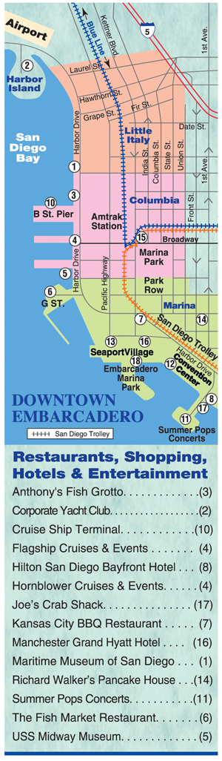
27 Casual Dining Venues Within 1/2 Mile of Manchester Grand Hyatt San Diego
On your own
Visit these websites for restaurant locations:
http://www.opentable.com/landmark/restaurants-near-manchester-grand-hyatt-san-diego?page=1
http://www.tripexpert.com/san-diego/restaurants/around/manchester-grand-hyatt-san-diego

Slide 18
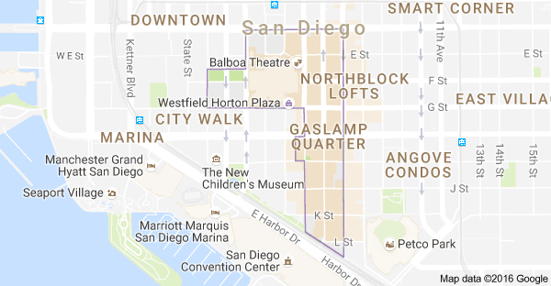
Gaslamp Quarter
URL:http://www.gaslamp.org/
Walk 16+ blocks of the West Coast’s premier entertainment district;
Dine with world-renowned chefs;
Dance the night away at nationally recognized nightlife venues.
On your own

Slide 19
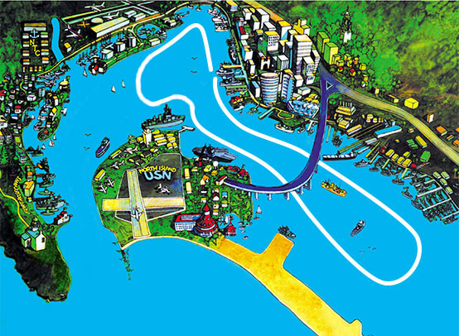
Address: | Embarcadero
URL Address: | URL: http://www.flagshipsd.com/cruises/patriot-jet-boat-thrill-ride
Phone #: | (800) 442-7847
Patriot Jet Boat Thrill Ride
On your own
Notes:
A 30-minute wet and splashing ride that travels up to 50 mph, doing 360 degree turns and stops on a dime.
This is definitely for adventurous types, who enjoy speed.
Children 4-12 years can participate; must be a minimum of 40” (100cm) to ride AND children must be accompanied by an adult.
Cost: $28.00, adults; $23.00, children

Slide 20



Shopping
Contact the Manchester Grand Hyatt San Diego Concierge for directions.
Horton Plaza An outdoor mall with dining and entertainment Transportation: Within walking distance | Las Americas Premium Outlet Mall on Border With 125 stores, Las Americas Premium Outlets® is the area's largest outlet center Address: 4211 Camino De La Plaza Transportation by Trolley: Take the San Diego Blue Line trolley to Las Americas Premium Outlets. Exit at the San Ysidro Transit center located at the international border. Las Americas Premium Outlets is located a short five minute walk across the pedestrian friendly bridge and one block up on the right.
Old Town If you are looking for unique gifts or souvenirs, a wide variety of shops line the streets of the main village Directions: Transportation by Trolley
Liberty Station Public Market, Arts District, Entertainment Address: 2640 Historic Decatur Rd Transportation: Taxi | Seaport Village Shops, eateries, entertainment Transportation: Walk behind Hyatt
Two major Shopping Centers are accessible by Trolley Fashion Valley – Upscale stores, eateries, and movie theater Mission Valley – Target, Macy’s, movie theater, and small specialty shops
On your own

Slide 21
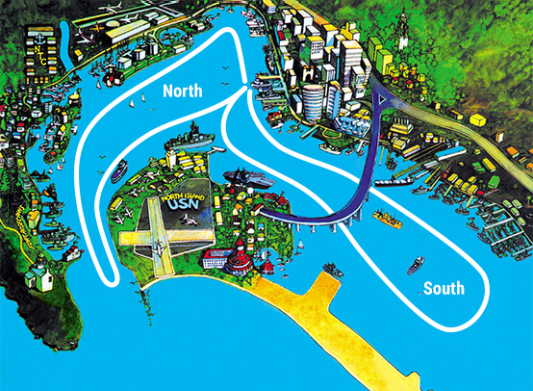
Flagship Cruises and Events
Address: 990 N Harbor Drive, San Digeo Phone: (800) 442-7847
URL:http://www.flagshipsd.com/cruises/san-diego-harbor-tour
San Diego Harbor Tours By Flagship Cruises
On your own
Notes:
This tour leaves from Ferry Landing on the Embarcadero, just past the Midway Carrier
The South tour features many Navy installations and ships.
The North tour includes downtown San Diego and North Island Naval Air Station.
Choose between tours or take the two-hour tour that includes both.
Cost: $37.00 for two-hour tour.

Slide 22
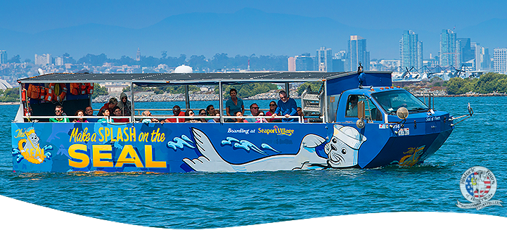
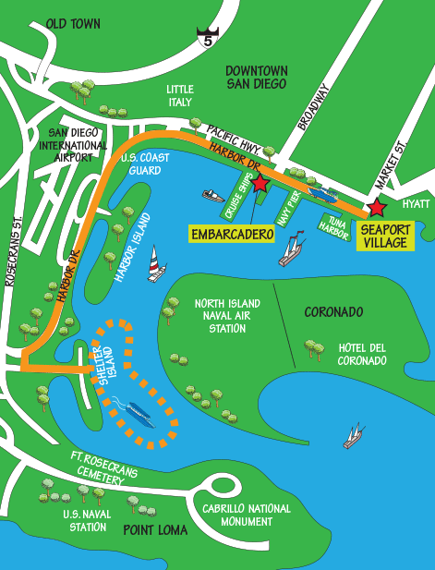
On your own
Seal Tour Information
Phone #: (866) 955-1677
URL: https://www.sealtours.com/
Notes:
You leave from the driveway in front of the Harbor House Restaurant in Seaport Village (directly behind the Manchester Grand Hyatt San Diego).
This amphibious vessel gives a tour of San Diego then enters the water at Shelter Island to allow visitors to view the city from the bay.
Cost: Adults $42.00 and Children $25.00 (4-12 years) or $10 (3 years and under).
Visit the Seal Tours website to take advantage of online reservation discounts!

Slide 23
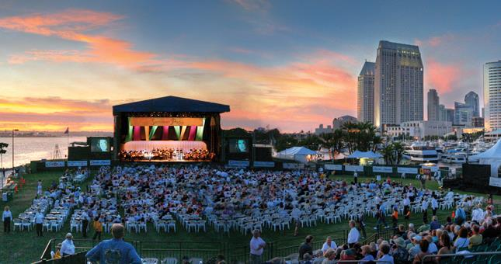
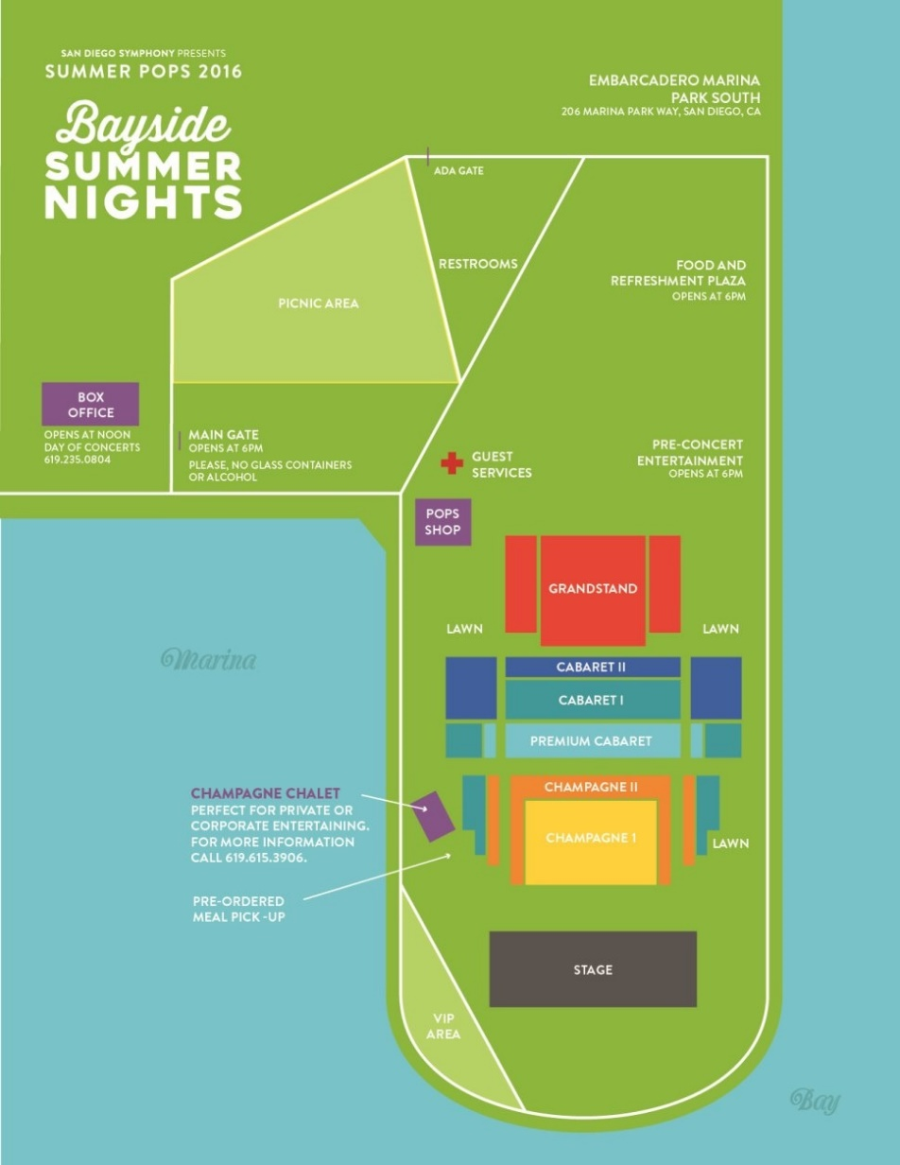
San Diego Symphony
Summer Pops 2017
On your own
Where: Embarcadero Marina Park South
Cost: $18-$76
This is where music lovers gather to enjoy a picnic on the lawn, share a bottle of champagne at reserved tables, or sit in the grandstand taking in the beauty of San Diego Bay.
The shimmering skyline and spectacular fireworks provide the perfect backdrop for enjoying the great San Diego Symphony and special guest artists.
For more information about dates and performances, please visit:
http://www.sandiegosymphony.org/

Slide 24
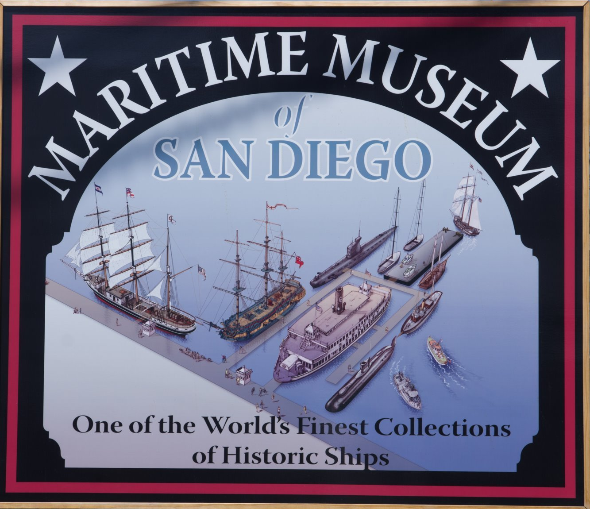
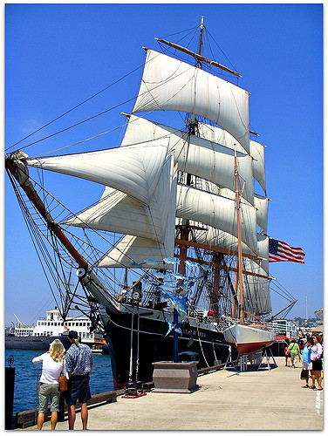
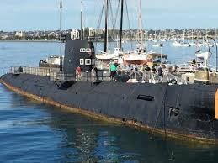
Url Link: https://sdmaritime.org/visit/the-ships/
Phone: (619) 234-9153
Street Address: 1492 N Harbor Drive, San Diego
On your own
Notes:
The Maritime Museum of San Diego features a world-class collection of historic vessels including sailing ships, steam-powered boats and submarines.
You can board and explore the ships.
Cost: Adults $16.00
    Teens $13.00
    Children $8.00
Star of
India
Russian Submarine

Slide 25

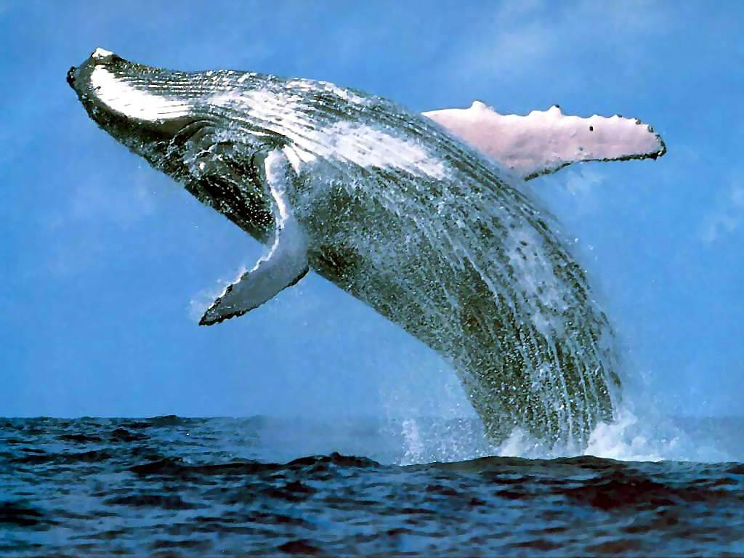
Whale & Dolphin Watching Adventure
On your own
URL:https://www.hornblower.com/port/overview/sd+whalewatching
Address: Embarcadero
Phone: (619) 686-8715
Notes:
This ocean tour goes to sea, looking for barking sea lions and pods of leaping dolphins as they search for whales.
The 3.5-hour tour has live narration by the captain and an on-board naturalist (from the San Diego Natural History Museum).
Whale sightings are not guaranteed.
Boards: 9:15 am - 1:00 pm
Price: $46.00 per person (Tax, service charge and landing fee may apply)

Slide 26


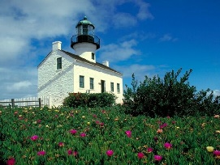


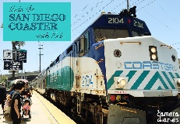








Family Friendly Activities Around San Diego
On your own
Hotel Del Coronado
Coronado Beaches
Old Town
San Diego
Cabrillo Monument/
Point Loma Tide Flats
Coaster
Train Trip
For kids
Safari Park
LegoLand
Disneyland
Liberty
Station
San Diego’s
Children’s
Museum

Slide 27
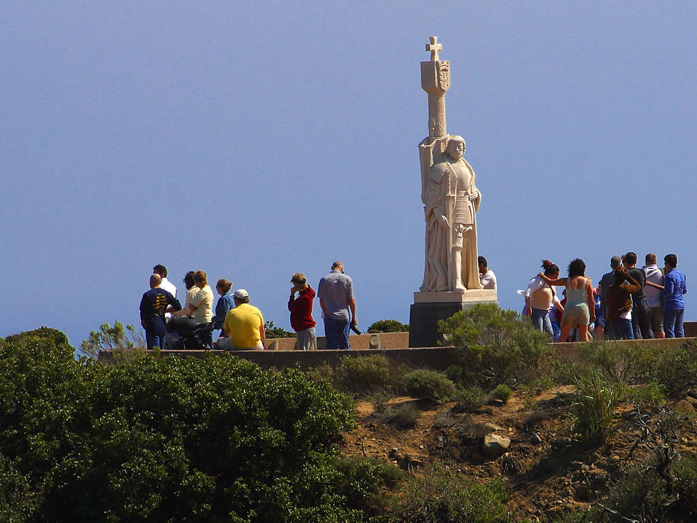
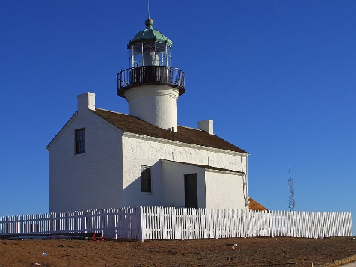
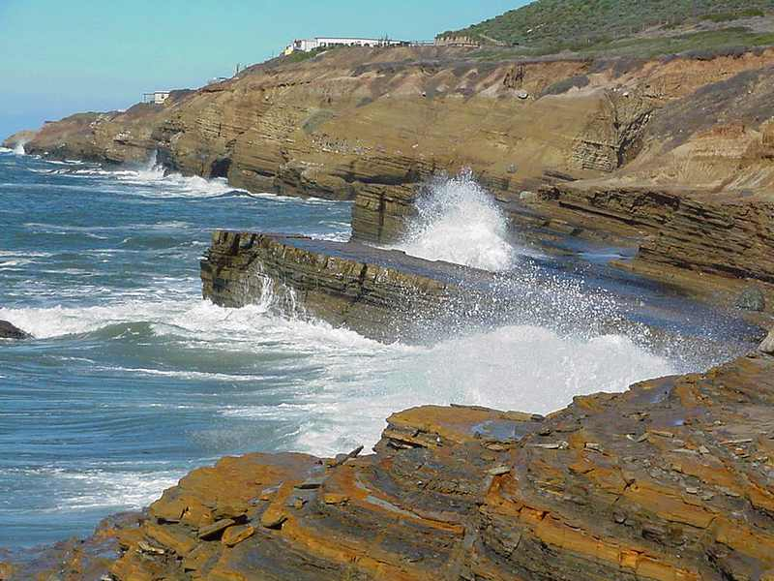
Cabrillo Monument at Point Loma National Park
& Point Loma Tide Flats
On your own
Street Address: 1800 Cabrillo Memorial Drive, San Diego
Phone: (619) 557-5450
URL link: https://www.nps.gov/cabr/index.htm
Transportation: On own; inquire at the Manchester Grand Hyatt San Diego Concierge Desk.
Pt. Loma
Lighthouse
Explorer Cabrillo
Statue
Pt. Loma
Tide Flats

Slide 28
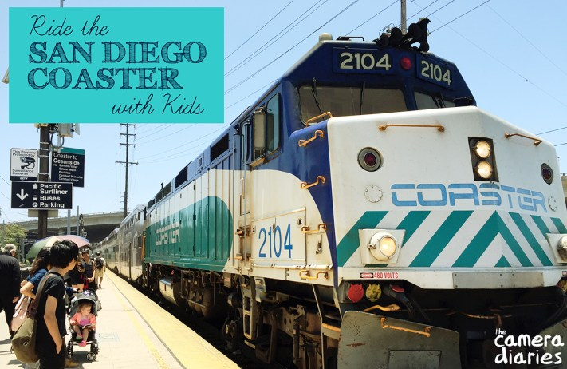
Coaster Train
Trip For Kids
All Day Event
The San Diego Coaster is a train that travels along the coast of San Diego County from downtown San Diego up to Oceanside.
Kids will enjoy the excitement of riding on a train, plus the ocean views outside the window.
Get off at just one Coaster stop, or explore the area around several of them during your day.
On your own
http://sandiego.about.com/od/funforthefamily/a/San-Diego-Family-Coaster-Crawl.htm
Directions:
Either walk or take Trolley to Sante Fe
Station to board Coaster train; ask the hotel
Concierge for Coaster times.

Slide 29

Disneyland: Happiest Place On Earth
It is possible to get there !!!
Information about Disneyland Street Address: 1313 Disneyland Drive, Anaheim | Amtrak: Transportation to Disneyland from Manchester Grand Hyatt San Diego https://www.amtrak.com/planning-booking
Phone#: (714) 781-4565 | Surfliner by Amtrak - San Diego – Santa Fe Depot 1050 Kettner Boulevard San Diego
URL Address: https://disneyland.disney.go.com/ | When you board, you will want to sit upstairs on the west side of the train to get the best views.
 | The Anaheim station is approximately 2.5 miles from Disneyland.
Amtrak offers train service on the Surfliner to Disneyland. The Surfliner leaves from Santa Fe Depot.
 | Once at the Anaheim station, buy a pass for Anaheim Resort Transportation directly to Disneyland or take a taxi to the park.
 | The trip takes just under two hours each way.
 | Check concierge for schedules and prices.
On your own

Slide 30
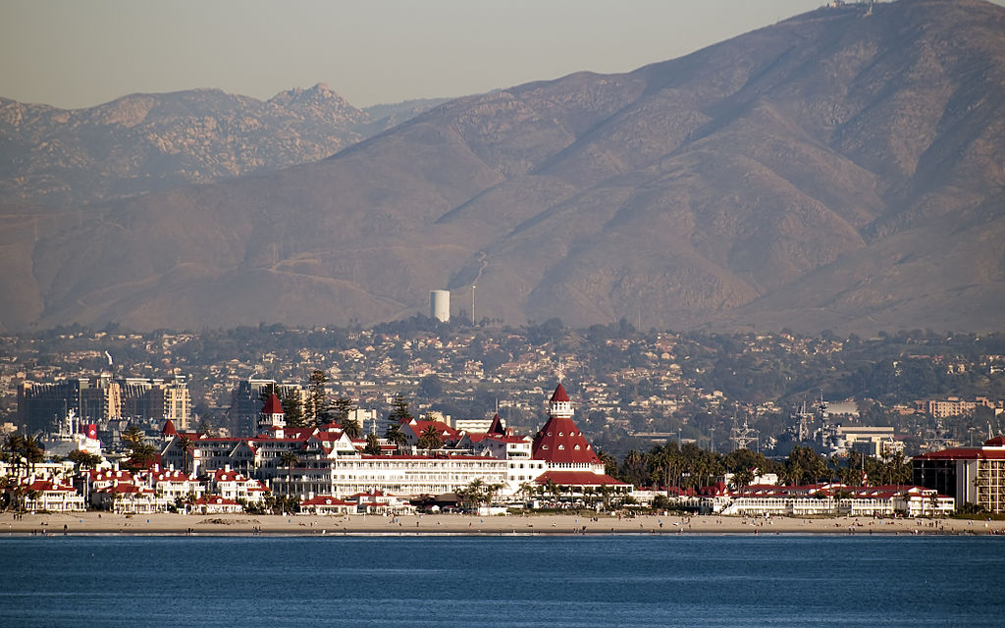
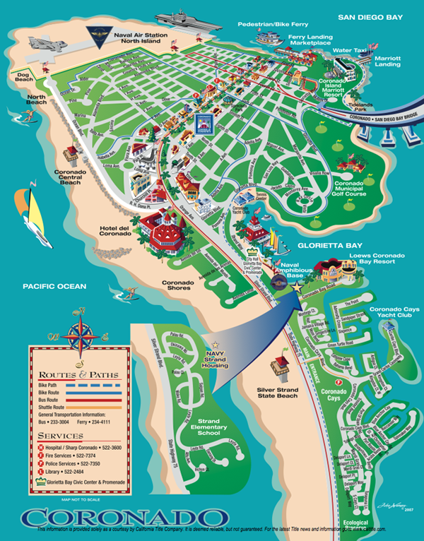

Hotel Del Coronado and Beaches via the Ferry
Family fun / romantic venues/ beach and water activities.
Ferry tickets may be purchased at: The Broadway Pier, 5th Ave Landing or Coronado Ferry Landing
Hotel Del Bus 904 Leaves from Ferry Landing in Coronado It will take you to Hotel Del Coronado. Day Pass is $5.00
Coronado Ferry URL: http://www.coronadoferrylandingshops.com/ferry-info Phone: (619) 234-4111
On your own

Slide 31


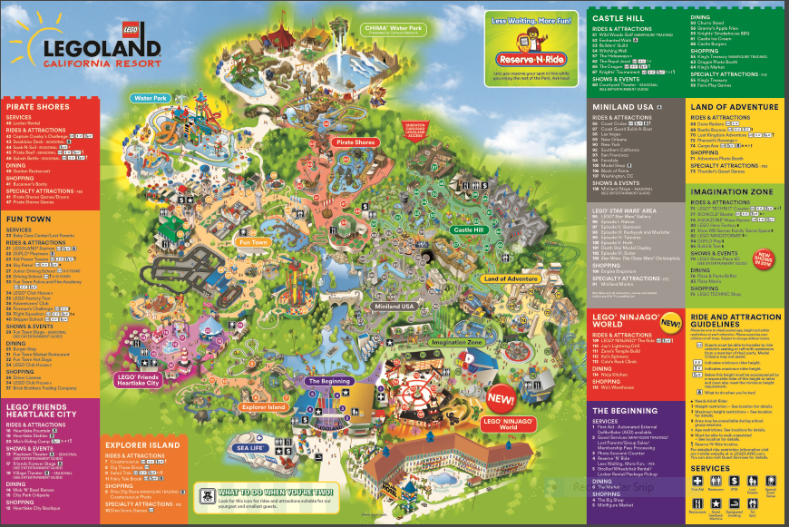
URL: https://www.legoland.com/california/ Address: 1 LegoLand Drive, Carlsbad, CA Phone: (877) 376-5346 https://www.legoland.com/california/aboutus/mobile-app/
On your own
Directions: Take the Coaster from Sante Fe Depot to Legoland Call “Carlsbad Flex” 855-844-1454 BEFORE you get on the coaster to arrange for bus shuttle to Legoland. Take the coaster from Sante Fe Depot to Carlsbad Poinsettia station then Flex to Legoland

Slide 32
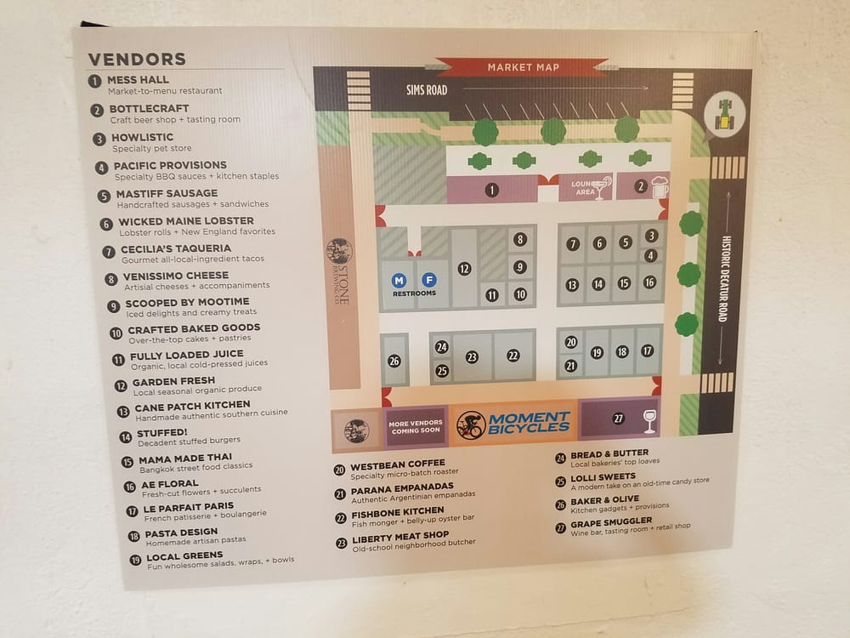


Liberty Station
On your own
http://libertystation.com/our-story/
Liberty Public Market is open 7 days 11:00 am to 5:00 pm – www.libertypublicmarket.com A rustic environment with prepared foods, beer, wine, produce, fish, desserts and pastries, pastas – located at 2640 Historic Decatur Road, Suite 140, San Diego. Arts and crafts, a test kitchen, and educational-driven events. Museums, movie theater, Corvette Diner, and Kid Ventures (indoor play center). Transportation: bus or taxi – ask Manchester Grand Hyatt San Diego Concierge.

Slide 33





On your own
Transportation: Take trolley across from hotel to Old Town Stop.
URL Links: http://www.oldtownsandiego.org/ http://www.oldtownsandiegoguide.com/
Try Taco Tuesday
in Old Town
Considered the "birthplace" of California.
Visitors can witness the living legacy of California's heritage in Old Town San Diego State Historic Park .
Its many preserved historic buildings and museums allow you to "go back in time" and visit California's history firsthand.

Slide 34


San Diego Safari Park
Originally a breeding facility affiliated with San Diego Zoo, it has become a tourist destination.
Check with Hyatt concierge for transportation options.
On your own
Address: 15500 San Pasqual Valley Rd, Escondido
Phone: (760) 747-8702
URL addresses http://www.sdzsafaripark.org
Transportation:
Taxi or Private Car

Slide 35

From creative classes to climbable sculptures, contemporary art for kids, in a bright, modern space.
Appropriate for young children
Ask Manchester Grand Hyatt San Diego Concierge for information
Address: 200 W. Island St, San Diego
Phone: (619) 233-8792
On your own

Slide 36


On your own
URL: https://seaworldparks.com/en/seaworld-sandiego/ Phone#: (800) 257-4268
Address: 500 Sea World Drive Opened: 1964 Area: 190 acres Elevation: 22.97′
SeaWorld San Diego is an animal theme park. It includes: Marine life shows Thrill rides Aquariums Up-close encounters with dolphins, penguins & more
Transportation: Green line toward Santee, exit Old Town Transfer to #9 bus Ask Hyatt Concierge for additional information
Photo credit:
Mike Aguilera/SeaWorld® San Diego

Slide 37







Awesome Adventure Activities in San Diego
On your own
Adventure Activities | Details and Information
Hot Air Balloons URL: http://www.sandiegoballoonrides.com/ | Just about every day of the year, San Diego Balloon Rides is available to gently float you over multi-million dollar estates of the rich and famous, capturing the views of the Pacific Ocean, Palomar Observatory, Catalina Island and the Mountains of Mexico.
Hang Gliding & Paragliding at Torrey Pines URL: https://www.flytorrey.com/ Address: 2800 Torrey Pines Scenic Drive, La Jolla Phone: 858-452-9858 | The Torrey Pines Gliderport is a city-owned private-use glider airport located in La Jolla.
Sportfishing https://www.hmlanding.com Address: 2803 Emerson St, San Diego Phone: (619) 222-1144 | H&M Landing is the West Coast’s oldest, most experienced sport fishing company, representing San Diego’s finest passenger fleet. There is action year round in San Diego at H&M Landing.
Farmer’s Market Coronado - Tuesdays 2:30-6:00 pm URL: http://www.welcometocoronado.com/coronado-living/coronado-farmers-market/ 1st St & B Ave, Coronado | Longtime, modest-sized market featuring fruits & vegetables from local growers.
Sailing/boat rentals http://www.seaforthboatrental.com/ Address: 333 W. Harbor Drive, Gate 1 at Marriott Hotel & Marina Phone: (888) 834-2628 | Large rental fleet includes sailboats, fishing boats, powerboats, personal watercraft. Sailing classes can be arranged.
Petco Park/Ball Game or Tour URL:http://sandiego.padres.mlb.com/sd/ballpark/tours/index.jsp Address: 100 Park Blvd, San Diego Phone: (619) 795-5011 | Petco Park, located in the downtown area of San Diego, California, is the stadium that is home to the San Diego Padres of Major League Baseball.

Slide 38






Mass Transportation for San Diego (MTS) | Other Transportation Possibilities
Trolley and Buses can all be easily accessed from Manchester Grand Hyatt San Diego Consider getting a refillable Compass Card for trolley, Coaster, Sprinter and bus - $2 URL: https://www.sdmts.com/fares-passes/compass-card | DECOBIKE: Rent a Bike http://www.decobike.com/sandiego/ Phone : (619) 297-0433 Apps:https://play.google.com/store/apps/details?id=com.decobike.sandiego
MTS Trolley Hyatt Stop 500 C St Phone #: 619-557-4555 URL: https://www.sdmts.com/schedules-real-time-maps-and-routes/trolley | The Free Ride Downtown Car Service Small cars with advertisements give free rides along Embarcadero Time: 7 am – 9 pm Monday - Friday Wave us down anywhere along our route http://www.thefreeride.com/contact.php
MTS Bus: America Plaza beside Sante Fe Depot Phone #: 619-557-4555 URL: https://www.sdmts.com/schedules-real-time/maps-and-routes | Water Taxi to Coronado URL:http://www.welcometosandiego.com/2011/07/san-diego-water-taxi-connecting-downtown-to-coronado/ Phone #: (619) 235-8294
Train: Coaster – Sante Fe Depot URL: http://www.gonctd.com/coaster Phone #: 760-966-6500 | General Information link: URL:http://www.smartdestinations.com/blog/getting-around-san-diego-2/

Slide 39



Mobile Apps:
San Diego Smart Apps
https://www.sandiego.org/press/press-releases/2013/san-diego-top-smartphone-apps-help-visitors-stay-connected.aspx
San Diego Zoo
http://zoo.sandiegozoo.org/content/zoo-apps
http://www.littleitalysd.com/about/little-italy-san-diego-mobile-app
Transit app:
http://free.mytransitguide.com/index.jhtml?partner=^BNH^xdm048&gclid=CKPztcrr2tACFQ13fgodt0kPyw
Old Town App –Walking Tour
http://www.gpsmycity.com/tours/old-town-walking-tour,-san-diego-2243.html

Slide 40

Downtown San Diego Map and Area Websites
General interactive map of all of San Diego https://discoverymap.com/san-diego-ca
Google map of San Diego attractions https://www.google.com/maps/d/viewer?mid=1hSJ7aN4dC2sEACZBOnGxu4gnxBM&hl=en_US&ll=33.51102142788528%2C-117.7990795&z=8
Downloadable maps of some of San Diego’s attractions http://ontheworldmap.com/usa/city/san-diego/
Notes:
For reproduction steps for this slide, refer to slide number 8 in this template.

